Slide 1
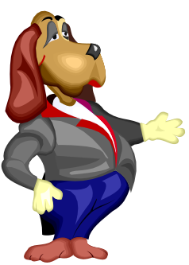

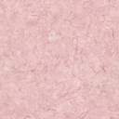






Whiteboardmaths.com
7
2
1
5
© 2004 All rights reserved

Slide 2
Shapes Intro
Recognising Fractions
Fractions show proportions. They compare the parts into which an object is divided with the whole object.
3 parts of this square are red.
There are 4 equal parts in total.
3
So we write fraction red =
4

Slide 3
Recognising Fractions
Fractions show proportions. They compare the parts into which an object is divided with the whole object.
2 parts of this regular pentagon are blue.
There are 5 equal parts in total.
2
So we write fraction blue =
5

Slide 4
Recognising Fractions
Fractions show proportions. They compare the parts into which an object is divided with the whole object.
5 parts of this regular hexagon are yellow.
There are 6 equal parts in total.
5
So we write fraction yellow =
6

Slide 5
Recognising Fractions
Fractions show proportions. They compare the parts into which an object is divided with the whole object.
3 parts of this regular octagon are blue.
There are 8 equal parts in total.
3
So we write fraction blue =
8

Slide 6
Shapes Questions
Recognising Fractions
Write down the fraction for the indicated colour in each case.
a
b
c
1
3
2
4
5
red
3
yellow
blue
d
e
f
4
7
5
green
pink
blue
10
12
9

Slide 7
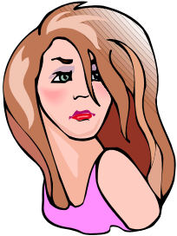
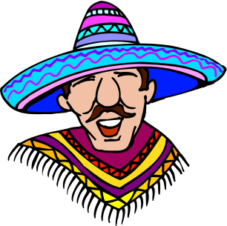
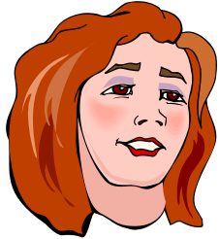
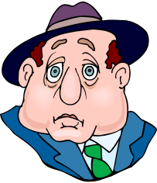
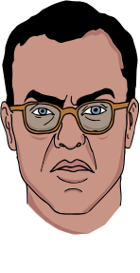

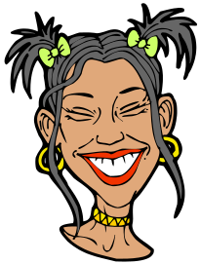

People
Recognising Fractions
Fractions can also be used to divide groups into separate categories or sets.
What fraction of this group of people are female?
There are 3 females
Out of a total of 8 people.
3
So fraction female =
8

Slide 8


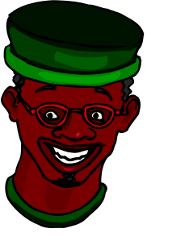
Recognising Fractions
Fractions can also be used to divide groups into separate categories or sets.
What fraction of this group of people are wearing hats?
There are 5 hats
Out of a total of 7 people.
5
So fraction wearing hats =
7
Notes:
What fraction “of” this group of people ….

Slide 9
Recognising Fractions
Fractions can also be used to divide groups into separate categories or sets.
What fraction of this group of people are wearing glasses?
There are 3 pairs of glasses
Out of a total of 7 people.
3
So fraction wearing glasses =
7
Notes:
What fraction “of” this group of people ….

Slide 10
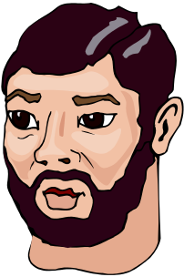
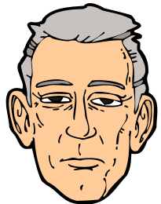
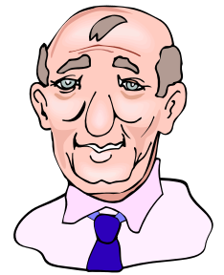
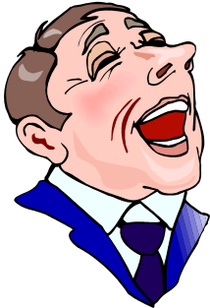
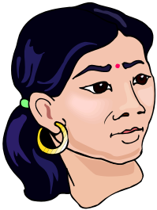


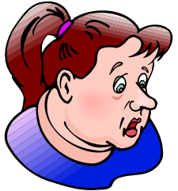
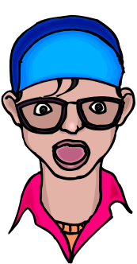
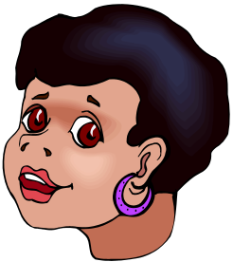
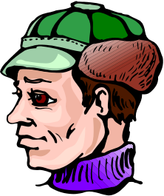
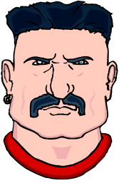
People Questions
Recognising Fractions
11
What fraction of the people are male?
18

Slide 11
Recognising Fractions
5
What fraction of the people are wearing hats?
18
Notes:
Answer to question coming up with the question

Slide 12

Recognising Fractions
8
What fraction of the people are wearing glasses?
18
Notes:
Answer to question coming up with the question

Slide 13
Recognising Fractions
3
What fraction of the people have beards?
15
Notes:
Answer to question coming up with the question
Does the black guy with the green hat have a beard?

Slide 14
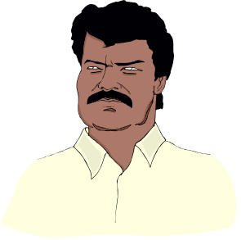
Recognising Fractions
4
What fraction of the people have a moustache?
15
Notes:
Answer to question coming up with the question

Slide 15
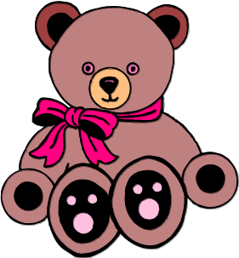
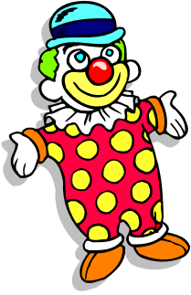


Toys Questions
Recognising Fractions
5
What fraction of the toys are teddies ?
12

Slide 16
Recognising Fractions
1
What fraction of the toys are clowns ?
12
Notes:
Answer to question coming up with the question

Slide 17
Recognising Fractions
7
What fraction of the toys are soldiers ?
12
Notes:
Answer to question coming up with the question

